Slide 1
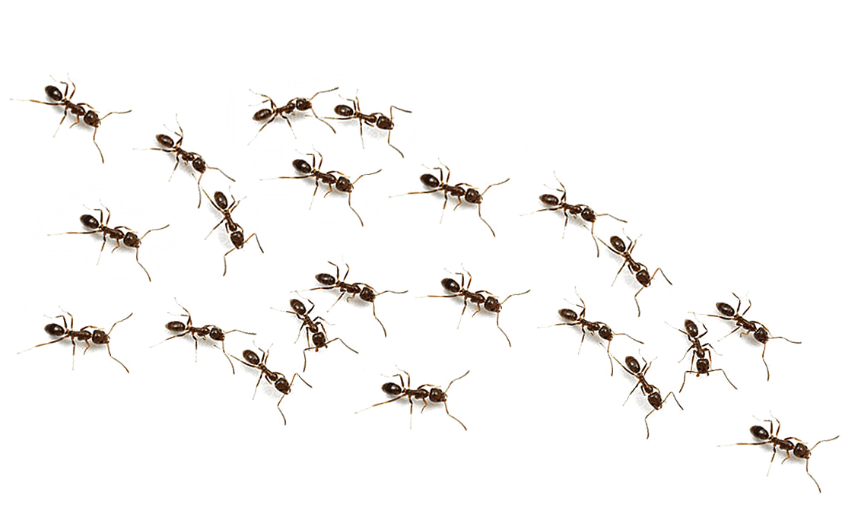


AntNet: an adaptive
nature-inspired algorithm
for routing in mobile ad hoc networks
Presented By
Pietro Martinello
29th January 2024

Slide 2
Report Outline
Introduction to ant foraging
PART 1
PART 2
The routing problem in dynamic networks
PART 3
A nature inspired solution
PART 4
The algorithm: how it works
PART 5
The parameters
02

Slide 3
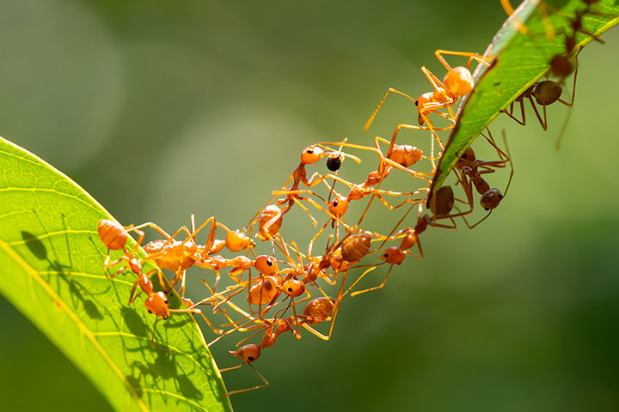
Ant foraging
Ant foraging is a collective process composed of the activities of individuals
as well as behaviorally integrated groups. This process enable ant colonies to find food in the environment they are located, to spread the information and to efficiently converge to the shortest path between food and the colony. All this is done using a chemical, stigmergic communication: the pheromone.
DAI project
29th January 2024
03

Slide 4
Ant foraging:
how does it work?
Out of the nest, ants start wandering around, searching for food
Once an ant finds some food, it will pick it up and start going back towards nest
When an ant is carrying food, it leaves on its path some pheromone, a chemical substance to which ants are sensible.
Pheromone spread by ants diffuse around
Surrounding ants will get attracted by the pheromone path, and will start following it, giving birth to a positive feedback cycle.
Eventually, the ensemble will converge to the shortest path between the food and the nest, even avoiding obstacles which may arise in between
Evaporation of pheromone guarantees collective adaptivity to environment changes
DAI project
29th January 2024
04

Slide 5
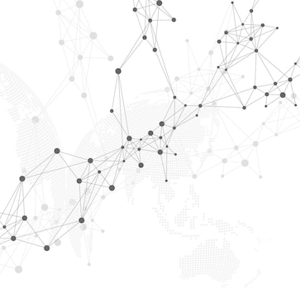

Applications
It has been showed by many studies that ant foraging can be taken as reference for several applications. Many of these applications involve networks:
Optimization of TSP networks
Routing in internet networks
Pervasive computing services
P2P service search
DAI project
29th January 2024
05

Slide 6
AntNet Project
This project is a NetLogo simulation of a distributed algorithm for routing in dynamic networks, inspired by and foraging process.
It relies over the study "AntHocNet" by Gambardella, Caro et al, 2005.
The algorithm combines reactive path setup with proactive path probing, maintenance and improvement. Paths are learned by guided Monte Carlo sampling using ant-like agents communicating in a stigmergic way.

Slide 7
The problem
The problem to be solved is how to make available a routing service in a dynamic network, where each node can:
Show up or disappear in any moment and in any place inside the network
Move inside the network, leading to structure changes
How can node A establish a communication towards node B in such an environment?
DAI project
29th January 2024
07

Slide 8
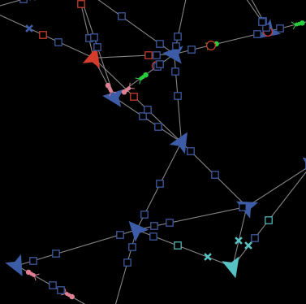
AntNet solution
Setup path only when needed
Forward ant agents are launched to the source across the network, searching for multiple paths to the destination. Once arrived at the target node, they are transformed into backwards ants and return to the source, setting up the paths.
Paths are represented by pheromone tables, indicating their respective quality. After path setup, data packets are routed stochastically over the different paths, using the pheromone tables.
While a session is active, paths are probed, maintained and improved proactively, using proactive ants
Algorithm reacts to link failures by warning preceding nodes who could get damaged by the loss, and by updating their pheromone tables.
Other than nodes and links, in the NetLogo simulation exist the following agents:
Ants: can be forward (pink) or backward (green)
Packets: can be user-messages (circular), hello-messages (squares) or link-failure-messages (crosses)
DAI project
29th January 2024
08

Slide 9
How it works
DAI project
29th January 2024
09

Slide 10
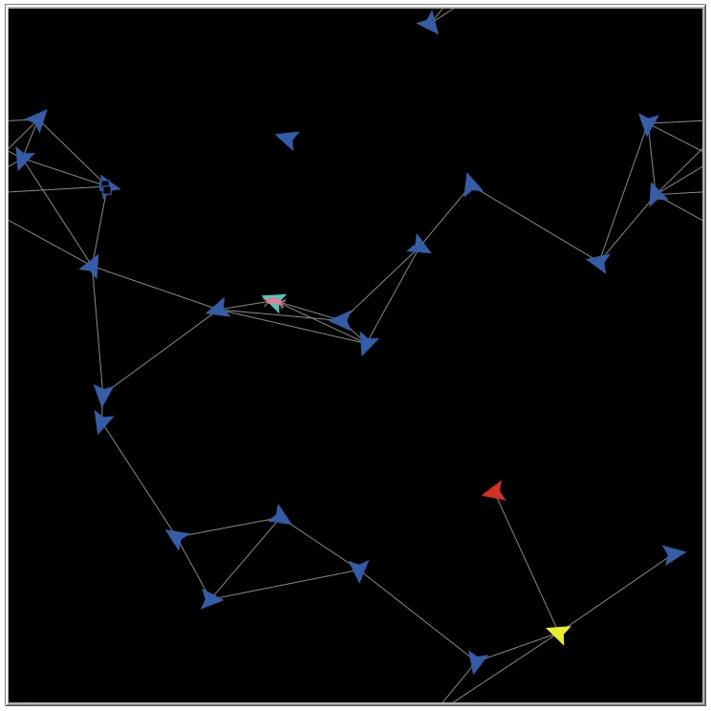
Reactive path setup
When a node wants to start a data session, it sends reactive forward ants to its neighbors.
Whenever a node receives a forward ant and doesn't know how to reach the target, it broadcasts the ant to all other neighbors. On the opposite, if it has some information, ants are sent stochastically, based on the local pheromone table.
Forward ants keep and update a list containing each visited node
When a forward ant reaches the target node, it becomes a backward ant and come back to the sender, by visiting nodes in its list in the opposite order.
While a backward ant travel along its path, it updates the pheromone table of each node with its data about how to reach the destination from the current node.
Pheromone tables, which are locally stored in each node, evolve over time with the network, and entries 'evaporate' when are not updated anymore.
DAI project
29th January 2024
10

Slide 11
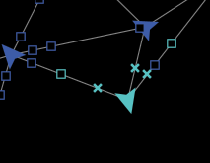
Proactive probing, maintenance and link failure detection
When a session is running, periodically the source sends proactive forward ants to probe the current paths and possibly to discover new paths. This leads to path improvements and variations.
Also, periodically nodes exchange 'hello-messages' with their neighbors. This simple mechanism is very useful, enabling a quicker convergence and the possibility to detect link failures.
When a link failure arise and is detected, a special packet 'link-failure-message' is sent to each of the nodes who could be involved in the loss. These nodes are the ones which had the lost node as part of the best path to reach one or more destinations. By updating the pheromone tables of these nodes, a distributed form of coherence is guaranteed without having a centralized database.
DAI project
29th January 2024
11

Slide 12
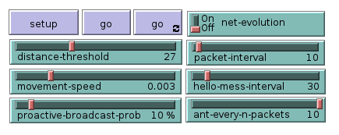
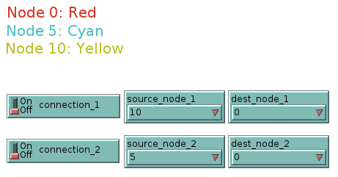
The parameters
net-evolution: decides if to move nodes with time or not
distance-threshold: how close two nodes should be the get connected?
packet-interval: How often data packets are sent during an active session
movement-speed: adjust the velocity of the agents
hello-mess-interval: how often hello messages should be sent?
proactive-broadcast-prob: probability of a proactive ant to be broadcasted
ant-every-n-packets: how often a proactive ant should be sent?
Connection parameters:
From this dashboard, you can set the active connection. For the sake of simplicity, just three nodes have been outlined with a different color. From here, it is possible to set up to two parallel connections.
12

Slide 13
Thanks for your attention
Pietro Martinello
257261@studenti.unimore.it

